Slide 1
Website Backend SOP Survey
March 2021

Slide 2
Financial Data #1: Tax Terms for Tax Filing & Return
Compute and reflect GST and PST on the invoice(and the order itself) accurately:
-Use the shipping address of the customer to compute collectible GST/HST and PST on the invoice in accordance to the provincial/territory’s tax regulations that the customer’s shipping address affiliates to:
5% (GST) in Alberta, British Columbia, Manitoba, Northwest Territories, Nunavut, Quebec, Saskatchewan, and Yukon
13% (HST) in Ontario
15% (HST) in New Brunswick, Newfoundland and Labrador, Nova Scotia, and Prince Edward Island
7%(PST) in British Columbia
-Automate collectible GST(HST) and PST and display them on the invoices’ total breakdown; Both GST and PST are calculated on the product total base, not overlapping or compounding one another.

Slide 3
Financial Data #2 Invoice Information
When clicking into and opening an invoice, it includes below information and features:
invoice number,
invoice date,
ABM’s contact information, including address, Tel#, Fax#, email address, GST number,
order number, customer’s internal PO number
customer ID,
shipment status on the supplied items;
color code items on the invoice as a differentiator in their shipping status(for example: shipped items can be all colored as green and unshipped items can be colored as white);
Payment terms(net 30) and due date
date the order shipped and via which company
payment status(fully paid vs partially paid vs unpaid), adjust the wording for paid invoice to receipt
Line items placed on the invoice(SKU, quantity, unit, description, list price, discount % and discounted price, if applicable only, final line cost

Slide 4
Financial Data #2 Invoice Information
When clicking into and opening an invoice, it includes below information and features:
subtotal , shipping, GST/HST, PST, bank fees, grant totals, amount paid
“Balance Due”:payable amount on the invoice(remaining balance to be paid)
If the invoice is printed on a date after the due date, have word adjusted as “Past due” show up in red below the grand total
Have the bill to information on the left-hand side and ship to information on the right hand side
If the ordered items are changed after order placement, it reserves the history of change on the invoice;
Produce a credit memo on the invoice, summarizing the cancelled and paid items- see next slide page
Enable to add and edit notes regarding payment related information and credit information on the invoice if any

Slide 5
Financial Data #2 Credit Memo
The title ‘‘Credit Memo’’ should on the upper right hand corner; credit memo should be accessed through the order and invoice; link the credit memo to the order and invoice itself. Credit memo number can be Cr-invoice number.
Credit memo comes into play whenever a customer cancel any paid items on an invoice. The system enables a manual option to select items included on the original invoice to be listed on the credit memo, and the selected items are stated on the description area of the credit memo. The quantity of each item can be optioned as well.
On the right side of the memo page, it indicates the breakdowns including Subtotal, Tax, and Total Credited or Total Refunded amounts. Total Credited or Total Refunded can be manually selected to appear on the memo depending on the option customers selected for. If its Total Credited, it adds ‘‘credit used” and the “credit Balance” on the credit memo.

Slide 6
Financial Data #2 Credit Memo
If a customer ask for a partial refund on a paid invoice for returned goods, the credit memo becomes the refund receipt and $0 should be added to the customer’s credit balance. In this case, Total Refunded can be manually selected to appear on the end of credit memo by finance team who initiates the Credit Memo in the system and the system should NOT count this refunded amount into the credit balance under the customer ID associated with this case.
If a customer ask for a partial credit on the paid invoice for their returned goods, the credit memo serves as credit for future consumption and the system should count this credited amount into the credit balance under the customer ID associated with this case. Once the credit is consumed by the customer sometime later, the credit memo should be updated and list the consumption process as ‘‘credit used” and the “credit Balance” on the credit memo should auto deduct the “credit used” value and recalculate the balance by the system itself.

Slide 7
Financial Data #2 Invoice Generation
Auto-generate Proforma Invoice against an order if the order is set on prepayment terms. Proforma Invoice numbers can be a new numeric series that are systematically assigned on its own.
Auto-complete previously generated Proforma Invoice, once items on the proforma invoice or the original order have been marked as shipped by logistics team.
Auto-generate an invoice against the same order after the Proforma invoice has been completed. The payment received from the Proforma Invoice should be transferred to the invoice itself; the invoice should clarify on it that the payable balance on the invoice is 0 and write ‘‘Please do not pay’’ so the customer are informed in a caring and professional manner upon receiving the invoice.

Slide 8
Financial Data #2 Invoice Generation
Auto-generate partial invoice against an order once some items have been marked as shipped by logistics team. Invoice value equals to the value for goods that are partially shipped.
Auto-adjust the partial invoice into a full invoice that contain all shipped goods once the rest of the shipped items have been marked as completed. Invoice value equals to total value of all goods shipped, from which partial payment amounts that has been received by finance team is deducted to show a current balance due on the invoice.

Slide 9
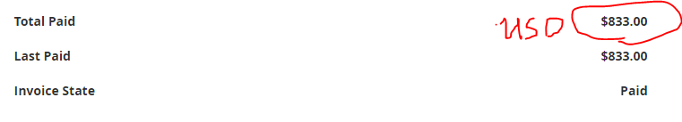
Financial Data #2 Invoice Generation
Auto-assign invoice currency based on customer’s address and display currency preceded to invoiced amounts. Currently it does not indicate the currency.
Display invoices in their assigned currency only.Current CAD invoices contain equivalent value in USD(highlighted in yellow), which causes confusion.

Slide 10
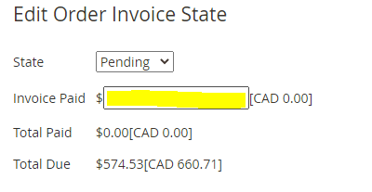
Financial Data #2 Invoice Payment Status
Enables a partial amount in its corresponding currency to be marked as paid in cases where customer paid a portion of the invoiced amounts. Current CAD invoices does not allow partial payments in CAD. Once fixed, we are allowed inputting of a certain canadian dollar amount to be marked as paid.

Slide 11
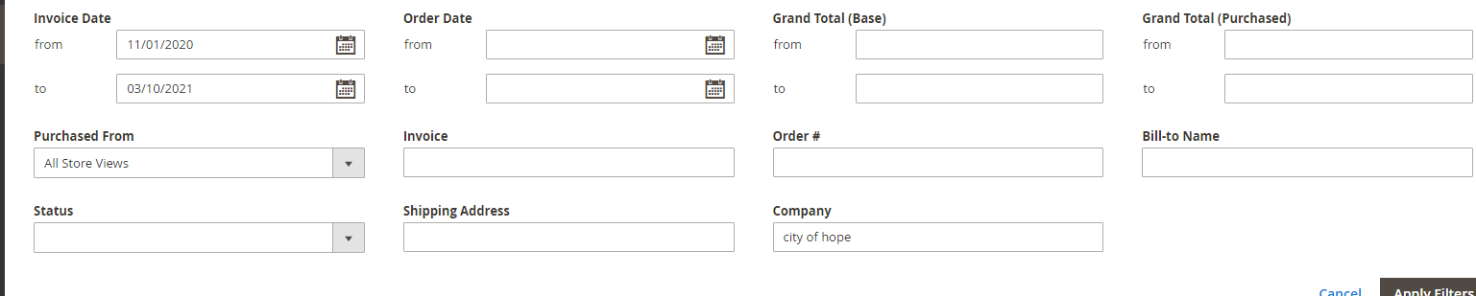
Financial Data #3 Customer Information
The current filters works well. It has been designated smartly in its nice configuration and this enable us to combine different filter searches into one single search. For example, we have the ability to search the result that meet both invoice date range and company name:

Slide 12
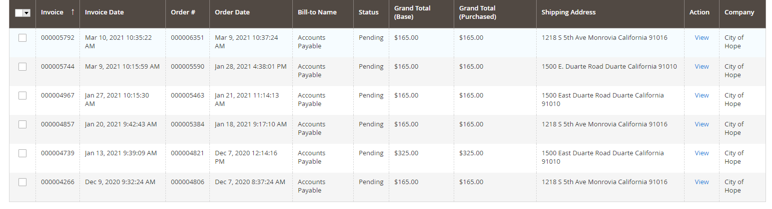
Financial Data #3 Customer Information
The current summary result after filtering on the index page include many columns that can be customized. If more columns including ‘current payable balance on the invoice’, it would enable customer statements to be pulled up at its complete accuracy. (index page attached below)

Slide 13
Financial Data #3 Customer Information
Provide customers’ AR related information and show customer’s payment portfolio and balance
1. Invoice Level:
When using filters to search for invoice on the invoice tab, the filters should include:
Invoice number, invoice date/period range, order number, customer ID, customer name, remitter name, certain amount range, invoice payment status(fully paid vs partially paid vs unpaid), proforma invoice searching

Slide 14
Financial Data #3 Customer Information
Provide customers’ AR related information and show the customer’s payment portfolio and balance
1. Invoice Level:
The summary result after filtering on the index page shows:
Invoice number, invoice date, order number, customer ID, total shipped values on the invoices, payment status(fully paid vs partially paid vs unpaid), invoiced amount; current payable amount on the invoice(remaining balance to be paid) etc.
The proforma invoice search should produce a display of all proforma invoices to be listed on the index page; proforma invoices should be in a different database from invoices and they should not share the same data source that the searching index is extract data from. Meaning when we select filters that do not include the filter option ‘proforma invoice’, none of the proforma invoice show up in the searching result even through some of them might meet our filter searching criteria.

Slide 15
Financial Data #3 Customer Information
Provide customers’ AR related information and show customer’s payment portfolio and balance
2. Customer Profile Level
Include Remitter information feature to each customer ID(Enable finance team to edit this information)
Every time a new order is being placed, a customer ID should be required to assign to the order.
Remitter information is auto-assigned as the company/institution name by the system at the time of order placement.
Enable finance team to edit this remitter information later on
Ability to search up all the customer IDs under the same company/institution name by inputting the desired company name in search index
Once an invoice is created against an the order, the customer ID on the invoice remains the same as the one on the order order. (Proforma invoice does not participate this step)
Ability to search up all invoices under a certain customer ID by inputting the desired customer ID in search index
Automate total balance due and total credit balance under a customer ID.

Slide 16
Financial Data #3 Customer Information
If a few more filters ‘proforma invoice’’ ‘‘remitter name’’ ‘‘customer ID’’ are added on, it would definitely enables us to better assist customer get their order out there faster. It also saves tons of time in gathering customer AR information, and and give an efficient method to collect payments like in AR chasing project!

Slide 17
Appreciate your help.
Thank you for helping improving a lot.

